Slide 1
Orientation for Postbacc Journal club (PBJ)
Minghao Gong, PhD

Slide 2
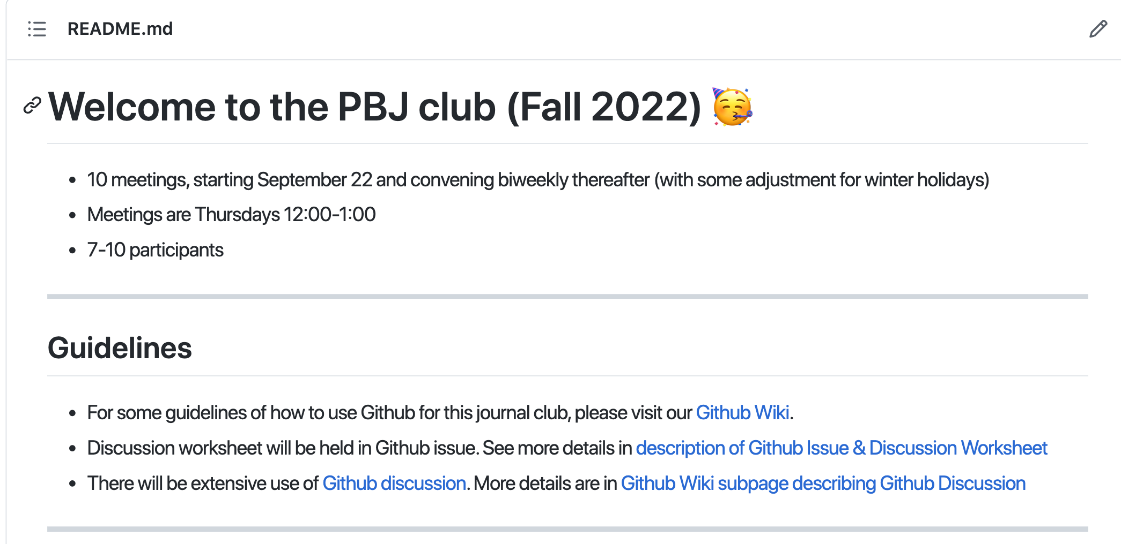
The PBJ will run completely under a dedicated Github repository
Github page: https://github.com/gmhhope/fall-postbacc-journal-club-2022

Slide 3
Let’s set up Github if you don’t have!
1. https://docs.github.com/en/get-started/signing-up-for-github/signing-up-for-a-new-github-account
Or search “Signing up for a new GitHub account"
2. Please let me know your Github account name in the chat box and I will add you into my repository.
Tip: try to put your full name in, otherwise other people may have hard time to find you. I am one of those notorious examples (@gmhhope)
3. Let me know if you can see the github repo https://github.com/gmhhope/fall-postbacc-journal-club-2022/
Tip: there will be two branches. One for `main` which is the main/master repository open to you. `dev` branch is meant for me to do experiment in the github. If you know enough Github and like to contribute, please fork this repository and make pull request to the branch `dev`.

Slide 4
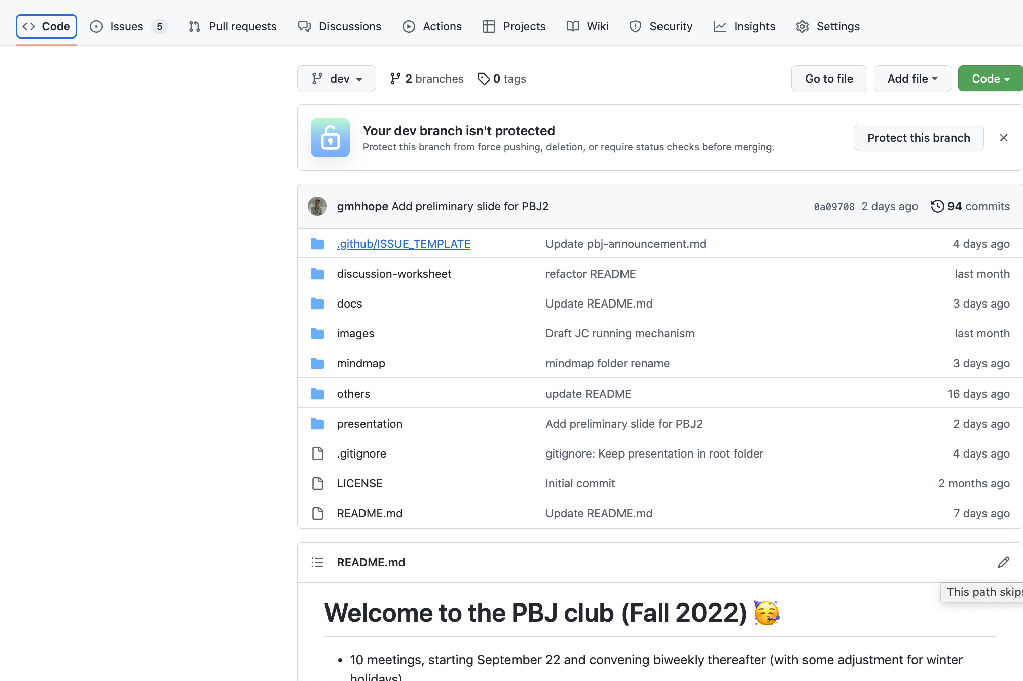
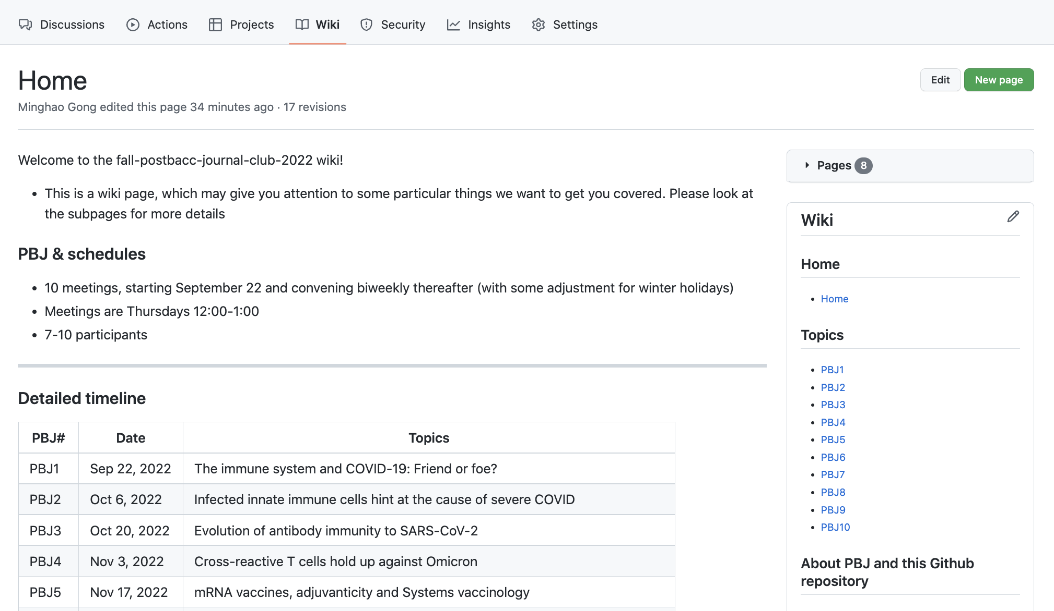
Github main page & wiki have everything you should know
Github main page
Github wiki

Slide 5
Github things? Look at Github wiki
Demo in Github wiki: https://github.com/gmhhope/fall-postbacc-journal-club-2022/wiki
`Topics` have links towards docs
Under `About PBJ and this Github repository`
Github Issue (e.g., Discussion worksheet or bug reporting)
Github Discussion (examples)
See `Explanations`

Slide 6
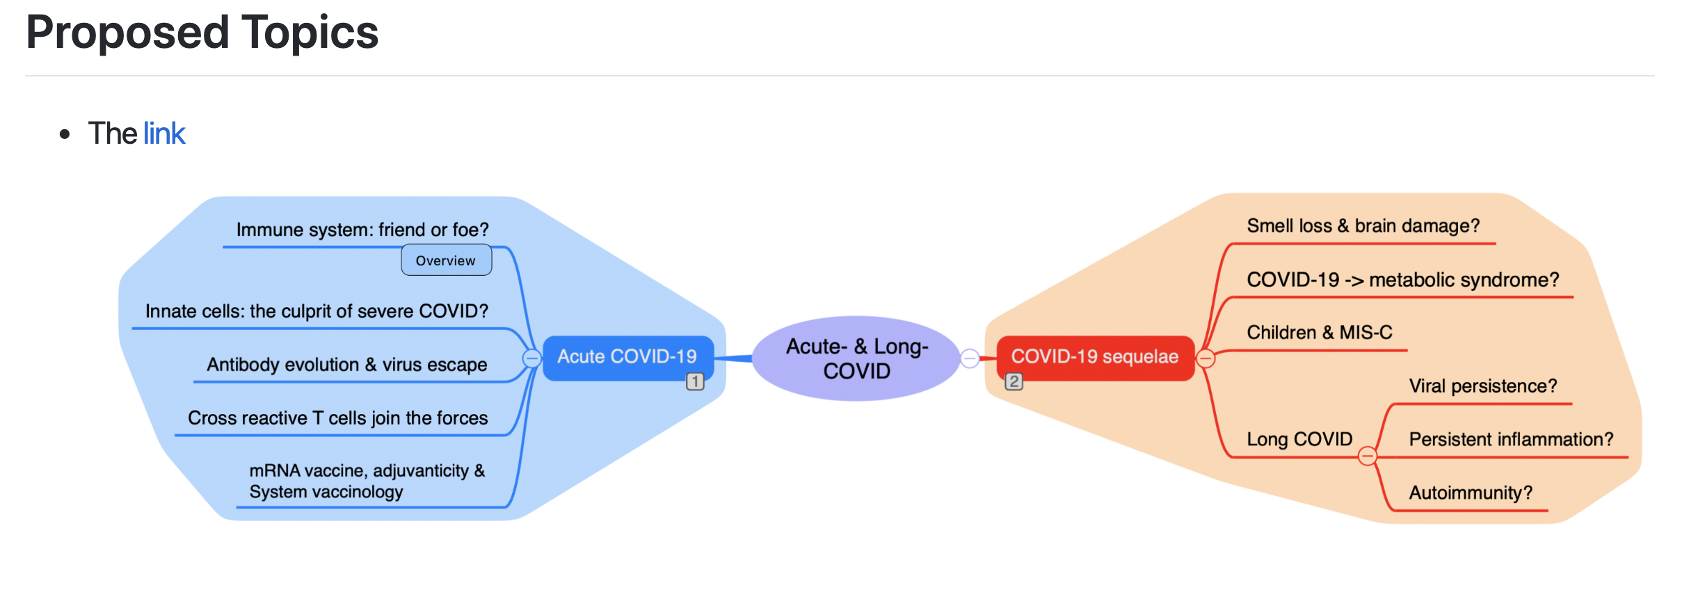

Slide 7
Requirements
First thing, go to announcement to see updates (or look up my emails*)
Listen, read, do poll, analyze, Q&A⁺ and present
Discussion worksheet (or reflection sheet)
A mindmap for explanation of discussion worksheet
Everyone will finish it under Github Issue
Everyone should run presentation >= 2x (wanna share & improve)
Participate discussion during the journal club
The PBJ leader is supposed to record presence/absence for each postbacc trainees
Report bugs in Github Issue if you found them!
Have fun!
*I will keep you updated for new announcements
⁺Please take a look at your Github notices (when you was @ (e.g., @gmhhope), you may be noticed for comments/questions/answers etc.

Slide 8
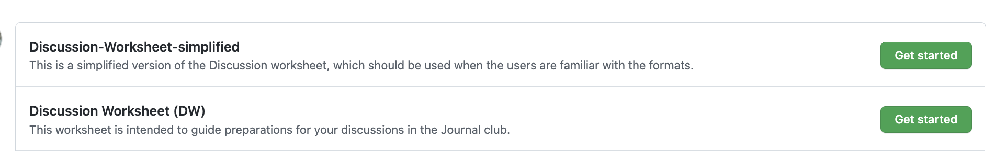
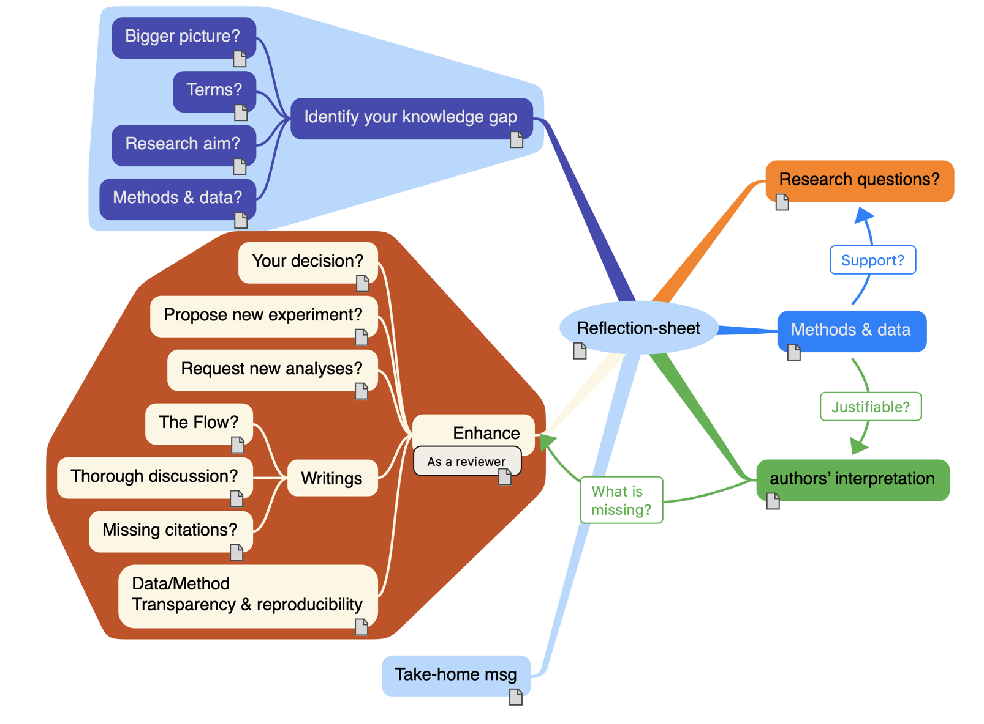
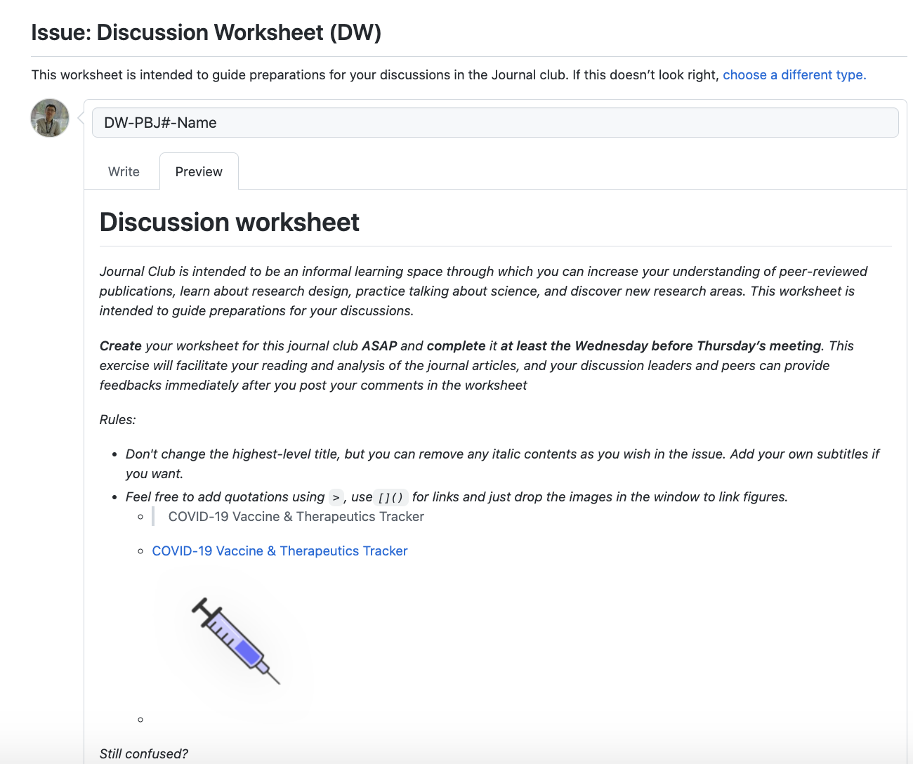
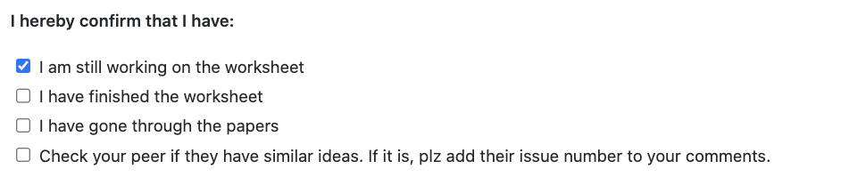
Discussion worksheet run through Github
Github Issue template
I will comment on your Github DW ASAP & It is welcome for everyone to comment on others’ DW.
I may also @ others to highlight comment questions or ideas
Preview on the ”Discussion-Worksheet (DW)

Slide 9
General Q&A
Where to find my reading list?
Where to do poll to select my paper of choice? Where to know the final results? (2 answers)
Where to find the official presentation?
Where to finish my discussion worksheet? You can do it step-by-step. Just check the box accordingly at the end of DW.
Where to post your presentation/Where to find my fellow’s presentation? Where to upload my presentation?
Where to post questions/help solve others’ puzzles? Your answers can be selected as best answer and let other know!
Where to post ideas? Better ideas to run the PBJ?
Where to post discussion items that you don’t know what categories should be? Or Github issue, select blank issue
Where to report bug?
Where to deliver your appreciation? 👏
Let me know if thing there can be more Q&A items here? (Please let me know your answer)

Slide 10

Proper citation & Zotero
If we have more time:
https://github.com/gmhhope/fall-postbacc-journal-club-2022/wiki/Proper-reference

Slide 11
After the PBJ1, please choose the papers you want to present
Add your names in the table showed in this github issue: https://github.com/gmhhope/fall-postbacc-journal-club-2022/issues/28
Don’t worry about the presentation. I will always help you by:
Directly share my opinion & add my edits via Show, tell & improve
I will create an office hour each week to discuss if you would like to. Let me know your best time
Try to team up with cross-campus teammates for presentation so that you can have new friends and I can always be of help in-person.

Slide 12
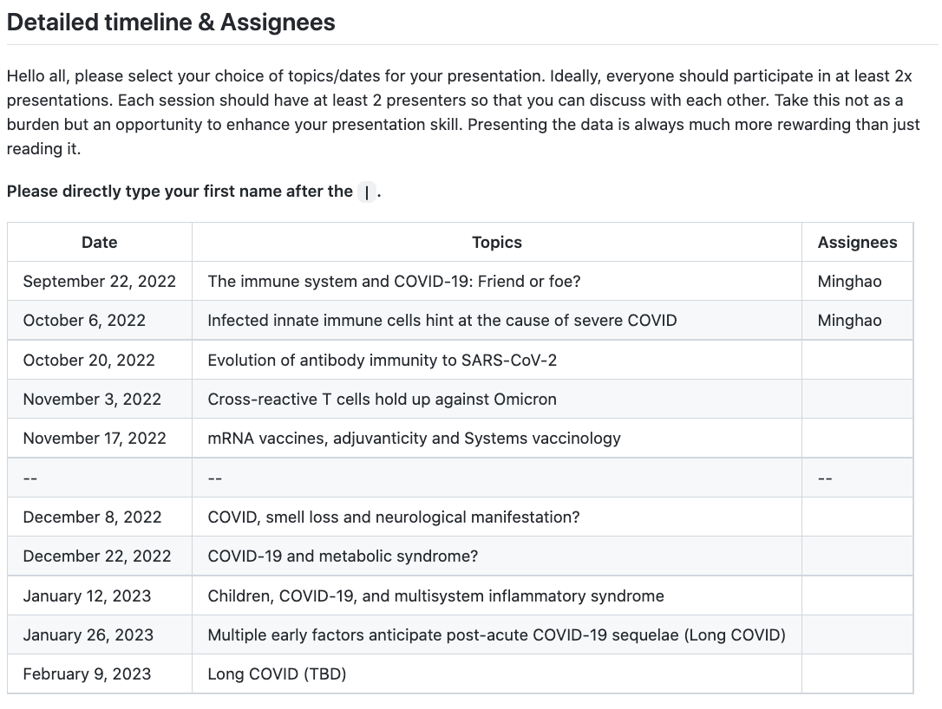
https://github.com/gmhhope/fall-postbacc-journal-club-2022/issues/28

Slide 13
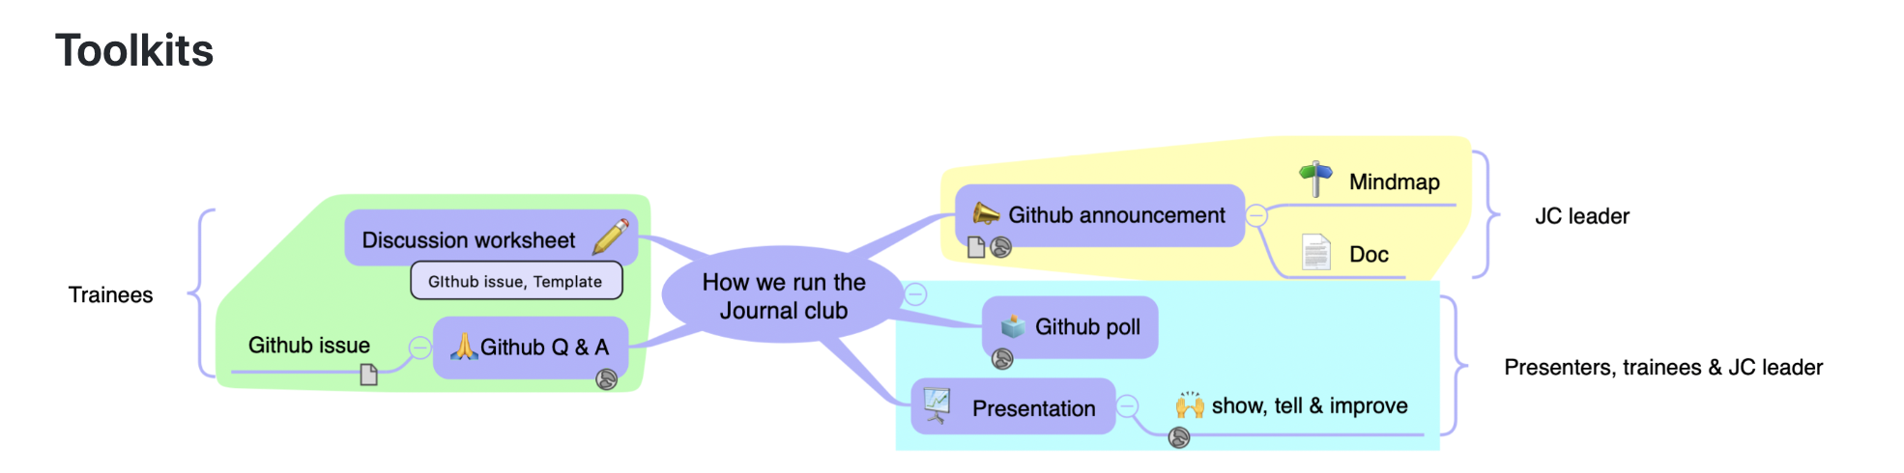

Slide 14
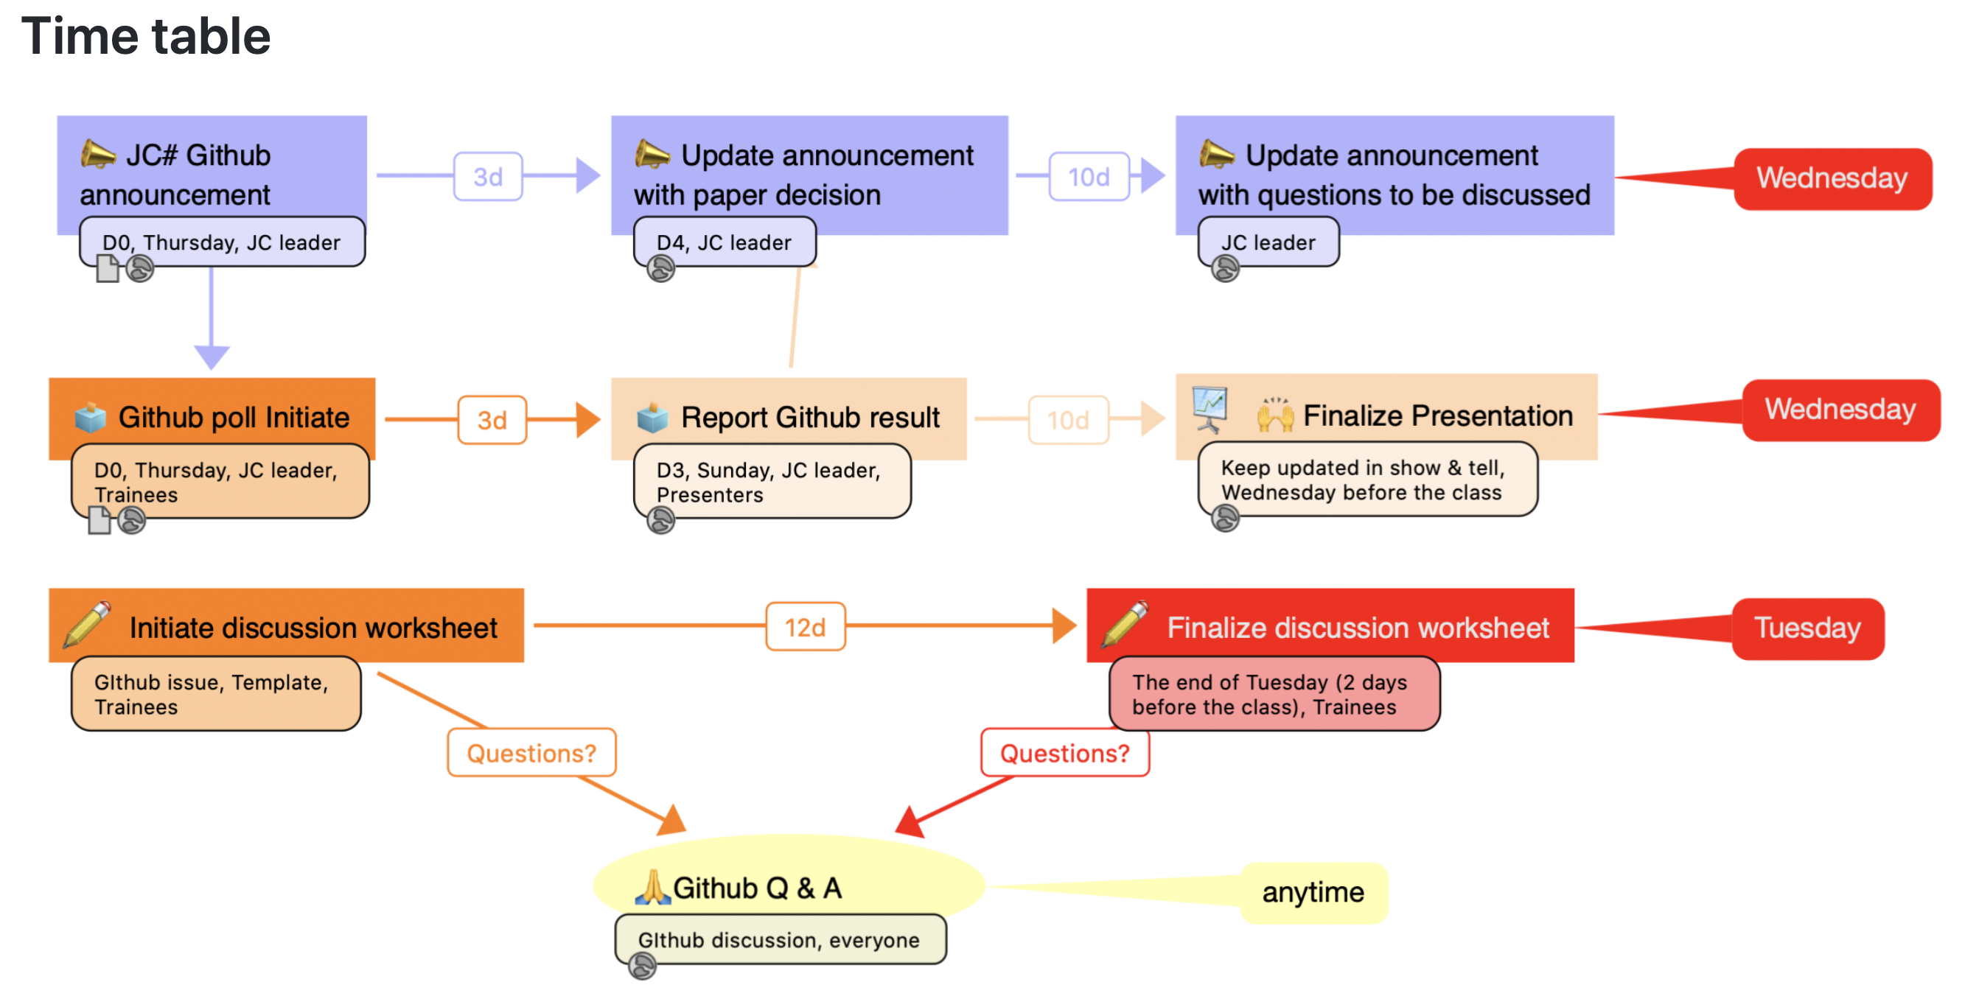

Slide 15
PBJ1: The immune system and COVID-19: Friend or foe?
Minghao Gong, PhD

Slide 16
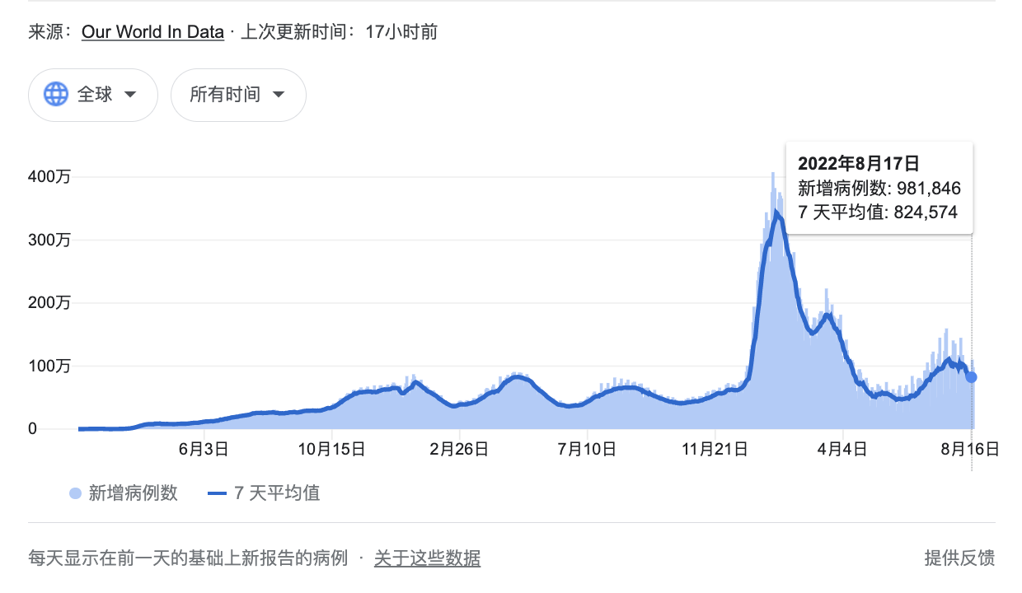
COVID-19 is not ending yet...
Notes:
I think I don’t need to introduce the COVID-19 as it has been with us for almost 3 years now. But look at the curve it is still a large number of cases. Although in US things are coming back to normal, in China, my home country, complete lockdown for a region can be still occurring and testing is still going on very frequently. People are still wearing masks.
In Africa and other less developed countries, vaccines are limited, so the COVID-19 is still evolving in those areas.
Moreover, considering the huge number of us have been experienced COVID-19, Sequalaes have emerged as one of the biggest health crises and require immediate attention. In this journal club, we sould going to look into these.

Slide 18
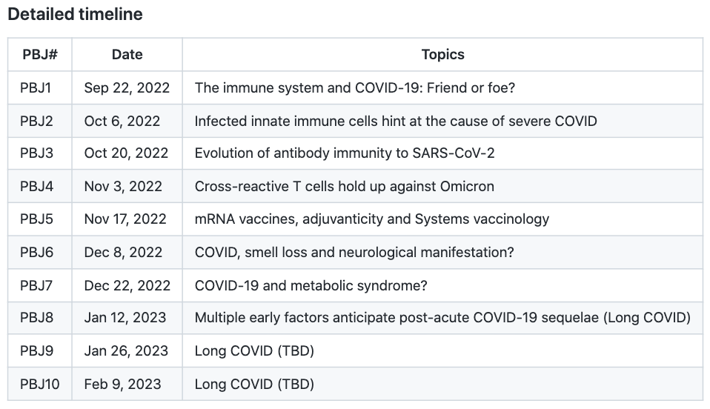
https://github.com/gmhhope/fall-postbacc-journal-club-2022/wiki

